Slide 1



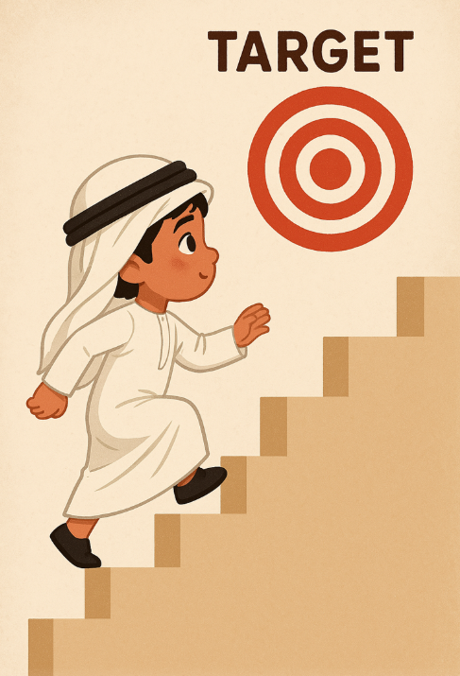
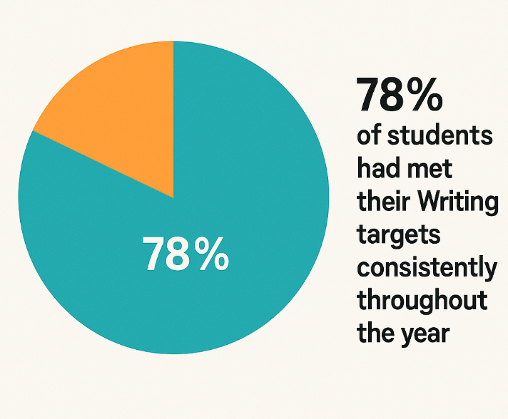
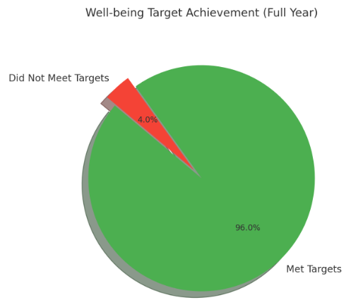
What is the impact of Emirati Achievement Trackers on student progress?
Introduction
Research
Conclusion
Conclusion
Research Action
Background
Reflections
Analysis
Research Questions
Results
Charlotte Tibbetts
May 2025
Methodology
I found that the Emirati Achievement Trackers have helped children make progress in Reading, Writing, Math, and Well-being. Moving forward, I would like to using the same model in subject areas such as Arabic, Islamic, Science and MSCS
Teachers in FS1 to Year 6 set individual targets for Emirati students in Reading, Writing, Maths, and Well-being.
Targets are shared with both students and parents to ensure transparency and support.
After 6 weeks, progress is reviewed using the following system:
Green Target fully met.
Yellow Target partially met; adjust target for next cycle.
Red Target not met; discuss with leadership to identify barriers and plan support.
New targets are then set for the next 6-week cycle based on review outcomes.
A questionnaire was designed using a scale score format.
Completed by 43 class teachers.
Emirati Achievement Trackers were analysed to measure student progress against Reading, Writing, Maths and Well-being targets.
Tracking the progress of Emirati students in Reading, Writing, Maths and Well-being is essential to understanding how effectively schools in the UAE are supporting student development. This research identifies strengths and gaps in learning, helping educators tailor interventions that improve outcomes. It also contributes valuable data to regional and international discussions on educational quality and equity. By closely monitoring student achievement, schools can make informed decisions, align strategies with national education goals, and ensure long-term academic success for Emirati learners.
I have shifted from a more generalized and less structured approach to progress tracking toward implementing a clear, systematic target-setting and review cycle every six weeks. This cycle is driven by data, using a straightforward color-coded system that helps communicate progress effectively to teachers, students, and parents. By regularly reviewing and adjusting targets, I am better able to support the individual needs of each student. Additionally, I have developed a practical framework for setting, sharing, and reviewing student targets that ensures transparency and accountability. This approach provides evidence that such cyclical tracking can improve student outcomes and promote differentiated teaching. Furthermore, engaging families in this process has strengthened support for students beyond the classroom, fostering a collaborative learning environment.
96% of children had met their Well-being targets consistently throughout the year.
85% of children had met their Reading targets consistently throughout the year.
89% of children had met their Maths targets consistently throughout the year.
78% of students had met their Writing targets consistently throughout the year.,
How does tracking student progress in Reading, Writing, Maths and Well-being impact teaching strategies in UAE schools?
To what extent does data-driven monitoring influence educational outcomes for Emirati students?
How do educators perceive the role of student progress tracking in improving academic achievement and informing school improvement efforts?
Results show that Emirati Achievement Trackers do increase students’ progress in Reading, Writing, Maths and Well-being.
References
Wardat, Y., Al Hammadi, F., & Al Darmaki, F. (2022). The influence of school factors on students’ achievement in Trends in International Mathematics and Science Study (TIMSS) in Abu Dhabi Emirate schools. Education Sciences, 12(7), 424. https://doi.org/10.3390/educsci12070424Almarashdi, H. S., & Jarrah, A. M. (2022). The impact of a proposed mathematics enrichment program on UAE students' mathematical literacy based on the PISA framework. Sustainability, 14(18), 11259. https://doi.org/10.3390/su141811259UNESCO. (2024). Progress of Sustainable Development Goal 4 in the Arab region [Report]. UNESCO. https://www.unesco.org/sites/default/files/medias/fichiers/2024/06/Progress%20of%20SDG%204%20in%20the%20Arab%20Region%20English%20%282%29.pdf

